Slide 1
Bohr’s atomic model

Slide 2
Democritus
Believed universe made of invisible units called atoms
• Named them Atoms
• 400 BC
• Aristotle said “He’s a quack!!!”
• Took 2000 yrs to be proved right!

Slide 3
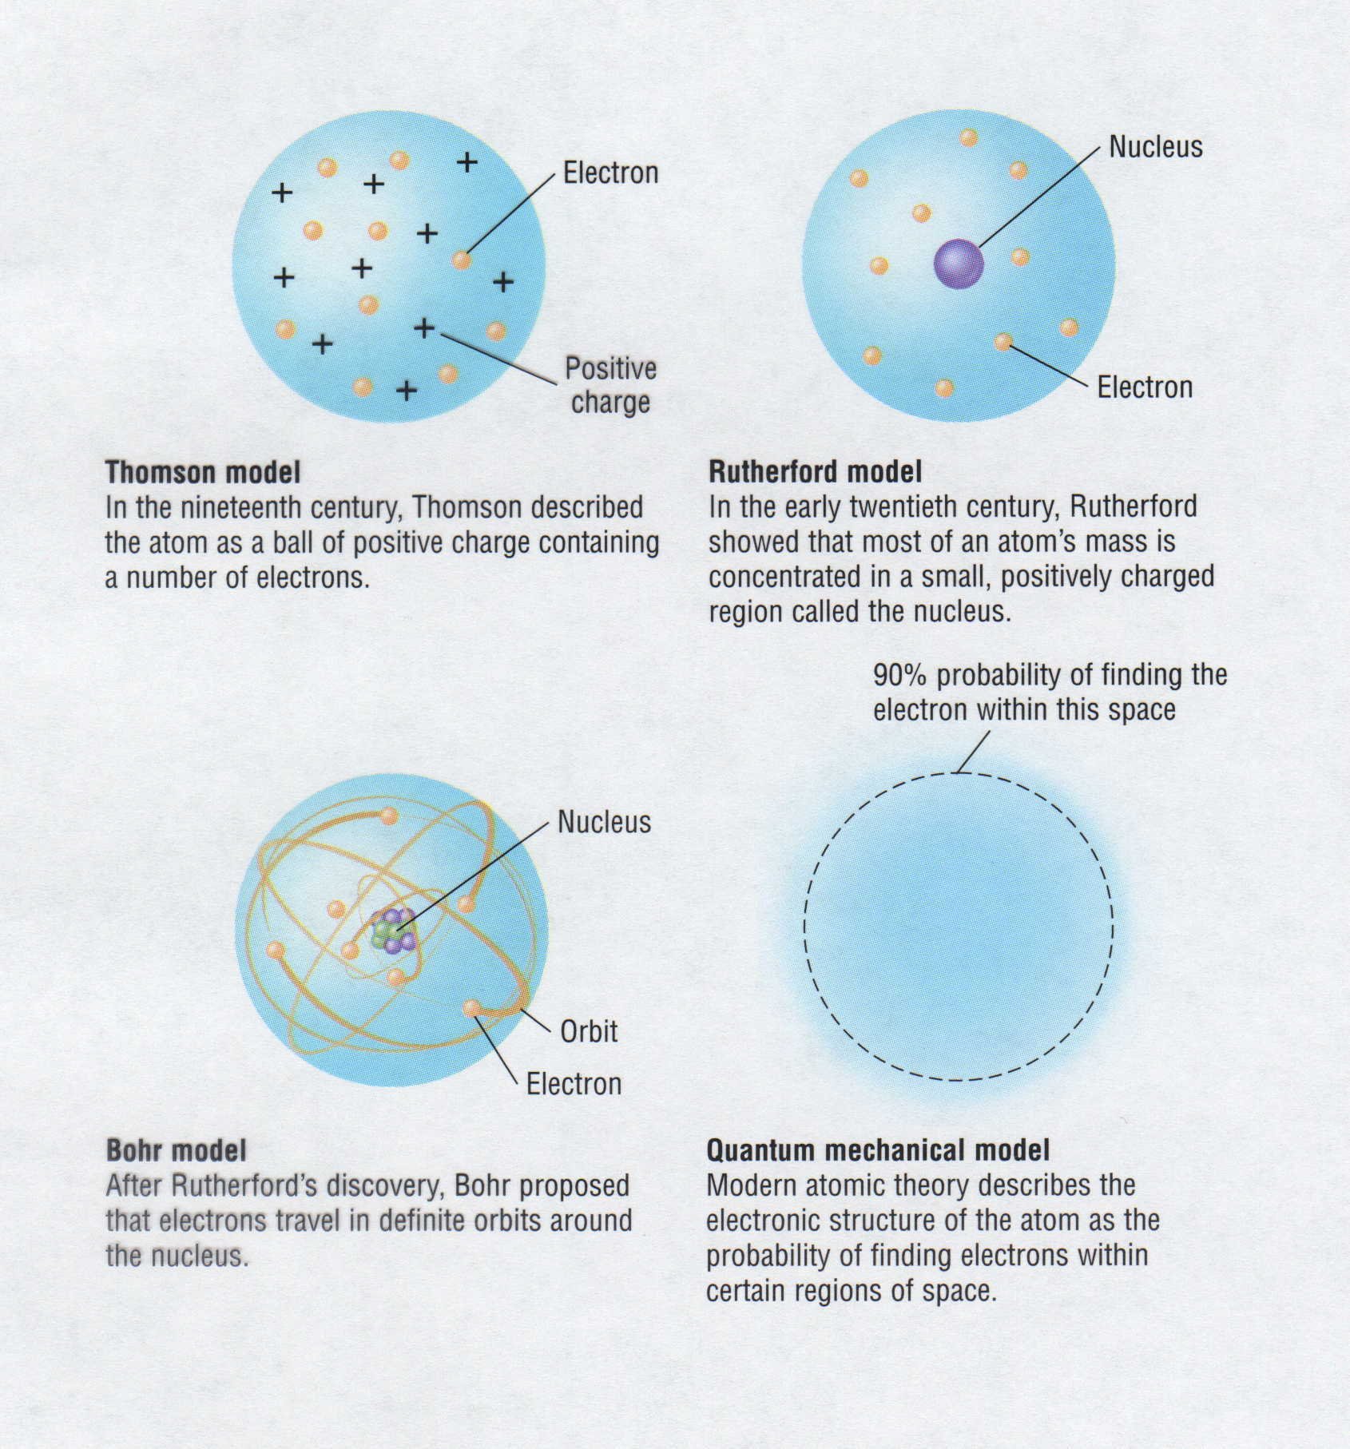
Development of Atomic Models
Thomson model
In the nineteenth century, Thomson described
the atom as a ball of positive charge containing
a number of electrons.
Rutherford model
In the early twentieth century, Rutherford
showed that most of an atom's mass is
concentrated in a small, positively charged
region called the nucleus.
Bohr model
After Rutherford's discovery, Bohr proposed
that electrons travel in definite orbits around
the nucleus.
Quantum mechanical model
Modern atomic theory described the
electronic structure of the atom as the
probability of finding electrons within
certain regions of space. (orbitals)

Slide 4
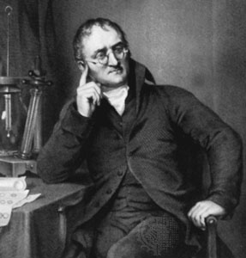
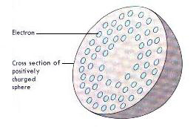
The Plum-Pudding
John Dalton (1803), England - formed the atomic theory, which states that all matter is composed of tiny, indestructible particles called atoms that are all alike and have the same atomic weight. This is first scientific model. Atom is un break able part, it has some positive(+ve) and negative(-ve) charges.

Slide 5

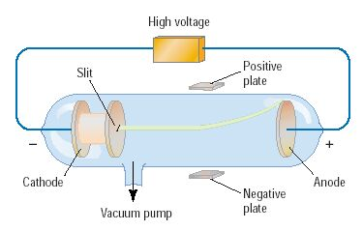
Discovery of the Electron
In 1897, J.J. Thomson used a cathode ray tube to deduce the presence of a negatively charged particle: the electron

Slide 6
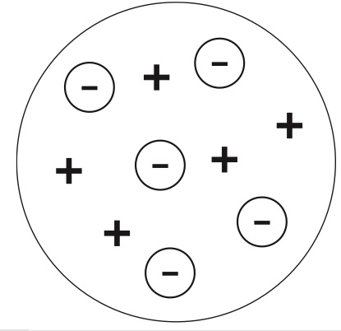
Thomson: “Plum Pudding” or “Chocolate Chip Cookie” Model
using available data on the atom, J.J. Thomson came up with the idea of having charges embedded with Dalton’s Billiard Balls
Also used cathode ray experiment to discover the existance of the electron
positive
(evenly distributed)
“dough”
part
negative
“chocolate”
10⁻¹⁰m
note: this model kept Dalton’s key ideas intact

Slide 7
J. J. THOMSON: He discovered the electron in 1891. The name of electron was suggested by Stony.
Thomson says that atom is uniformly distributed. There is no empty space inside the atom. Electron are in static equilibrium with positive (+ve) charge.
DRAW BACKS: No concept of nucleus. Most of alpha particles passed from gold foil, few are deflected through large angle, some are bouncing back.

Slide 8

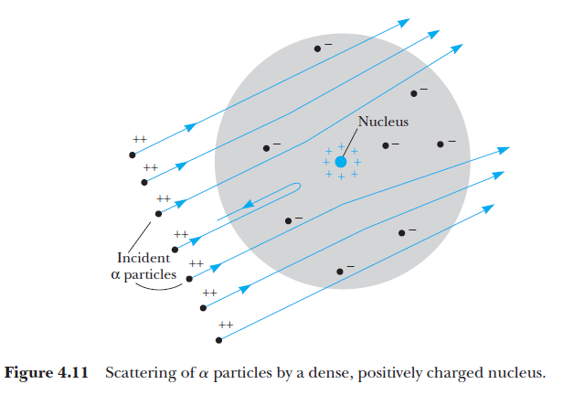

Rutherford’s Atomic Model
Rutherford proposed that an atom has a very small positively charged core (nucleus) surrounded by the negative electrons.
note: this model completely changed the definition of atom

Slide 9
RUTHER FORD (1909): He used the results of his gold-foil experiment and discovered the nucleus, free space within an atom, that’s why alpha particles passed easily from gold foil.
Total charge on nucleus. Atom is like solar system. Nucleus consists protons and neutrons.
DRAW BACKS: Total charge on nucleus, electrons moving around nucleus, during motion they radiating energy and will fall in nucleus.

Slide 10
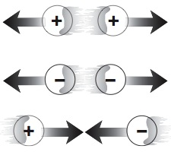
New Evidence
during the 1900s evidence was discovered regarding charges:
atoms have positive (Rutherford’s contribution) and negative (Thomson’s contribution) parts
charges interact:
as a result, revisions to Dalton’s model had to be made

Slide 11

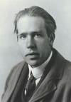
Niels Bohr
Discovered that electrons exist in several distinct layers or levels
“Jimmy Neutron Model”
Travel around nucleus like planets travel around sun
Electrons Orbit
Electrons can jump between levels with energy being added/released

Slide 12
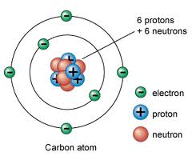
Bohr's Model of the Atom Bohr's model:
electrons orbit the nucleus like planets orbit the sun

Slide 13
Bohr's Model of the Hydrogen Atom
Bohr's model of the hydrogen atom is based on four assumptions. The first two are specific to his model. They are as follows:
The electron in a hydrogen atom moves in a circular orbit about the nucleus.
Only certain circular orbits are allowed. In these orbits the angular momentum h/2π of the electron is quantized, just like energy is quantized in Einstein's photon model of light.

Slide 14
Bohr's Model of the Hydrogen Atom
The next two assumptions are more general:
Electrons do not give off electromagnetic radiation when they are in an allowed orbit. Thus, the orbits are stable.
Electromagnetic radiation is given off or absorbed only when an electron changes from one allowed orbit to another. If the energy difference between the two allowed orbits is ΔE, then the frequency, f, of the photon that is emitted or absorbed is given by ΔE = hf.

Slide 15
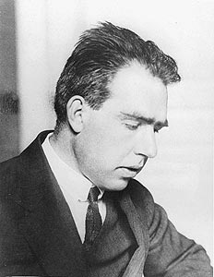
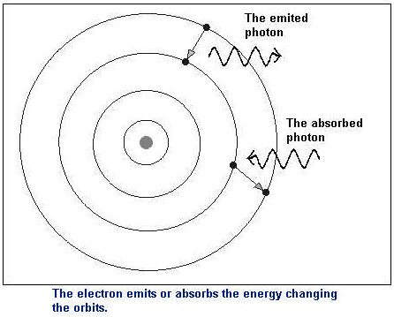
Bohr’s idea
“Allowed”
orbits

Slide 16
Bohr's Model of the Hydrogen Atom
To summarize, Bohr's model retains the classical picture of an electron orbiting a nucleus. It also adds the quantum requirements that only certain orbits are allowed and no radiation is given off from these orbits.
To determine the allowed Bohr orbits—those with specific radii and specific energies—we apply two conditions.
First, the electron moves in a circular orbit of radius r and speed v,

Slide 17
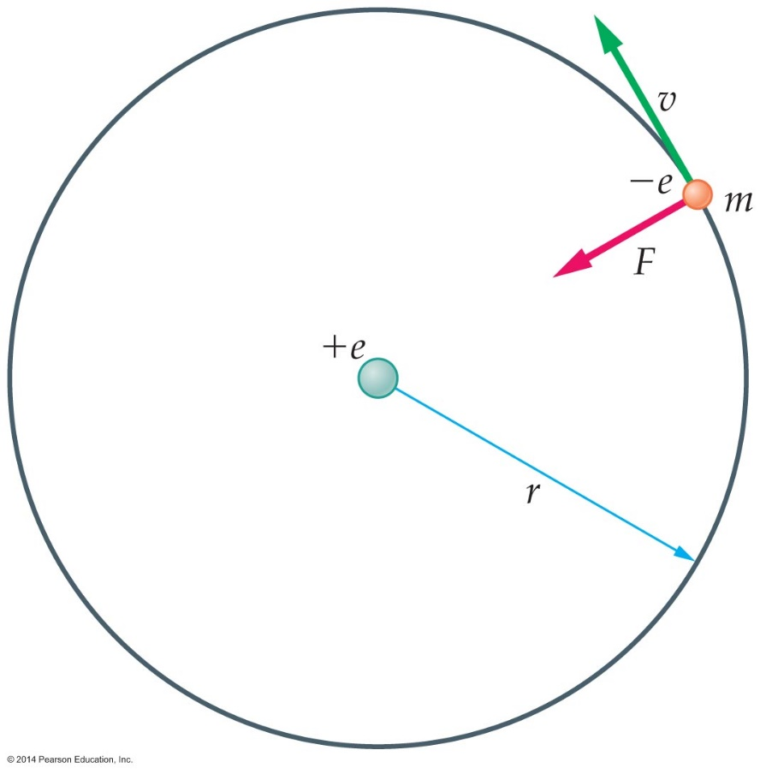
Radius of Bohr's Model of the Hydrogen Atom
As a result, the electron experiences a centripetal acceleration toward the nucleus of magnitude a = v²/r.
From Newton's second law of motion, we know that a force, F = ma, is required to produce an acceleration. In this case, the force is the electrostatic force F = ke²/r².

Slide 18
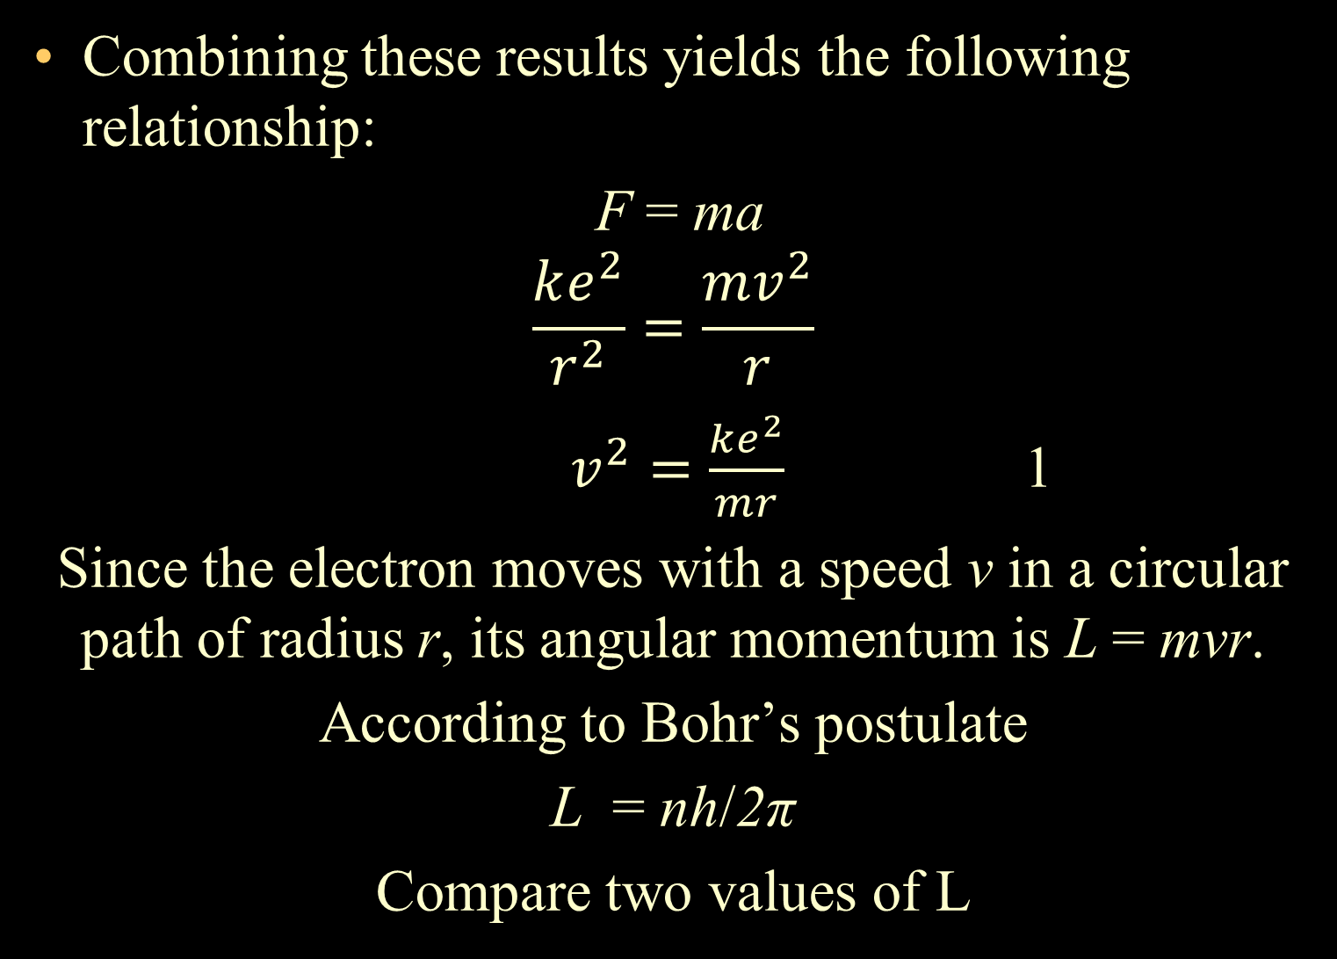
Radius of Bohr's Model of the Hydrogen Atom

Slide 19
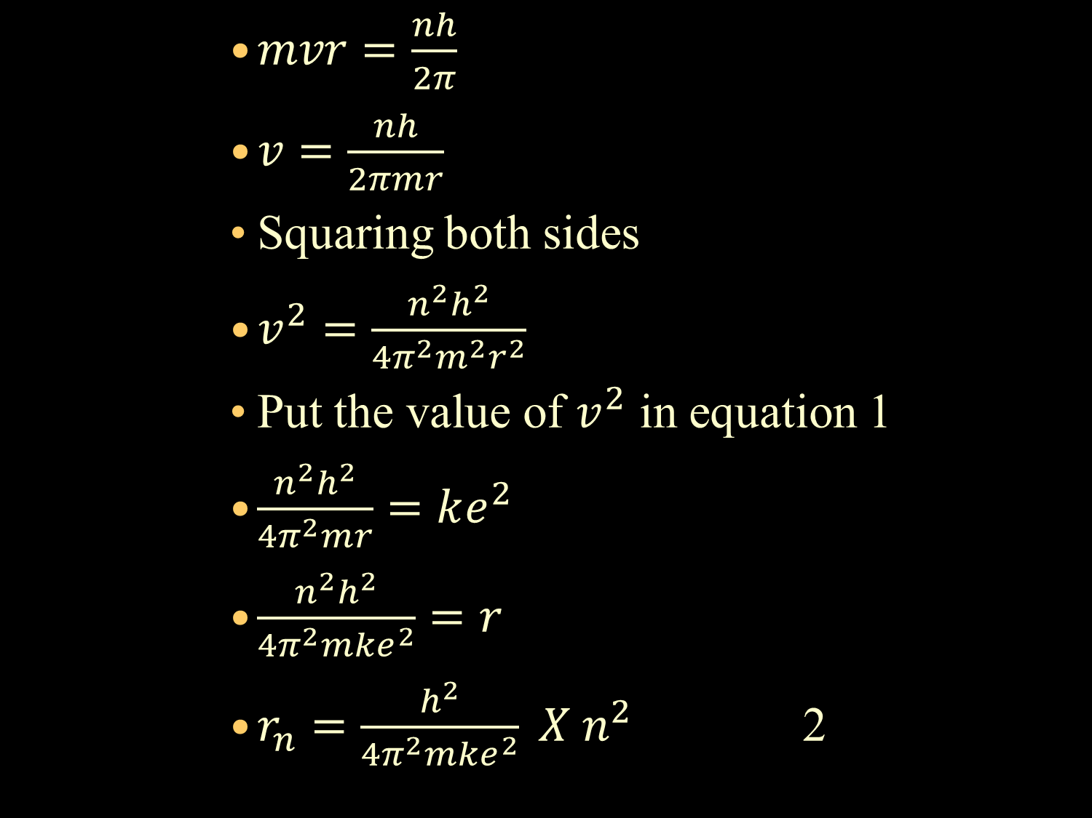

Slide 20
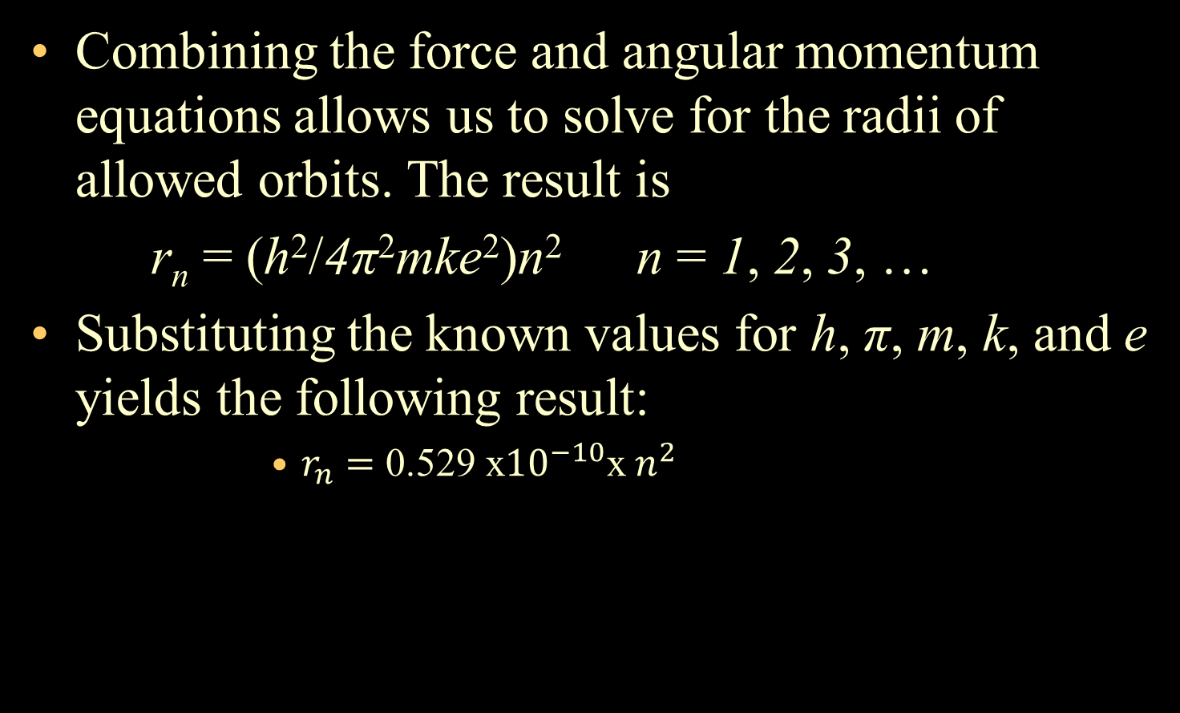
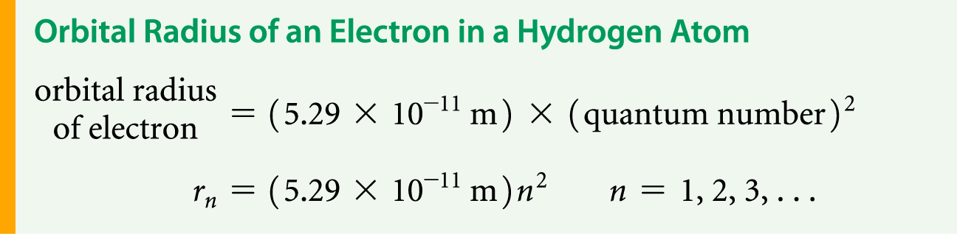
Bohr's Model of the Hydrogen Atom

Slide 21
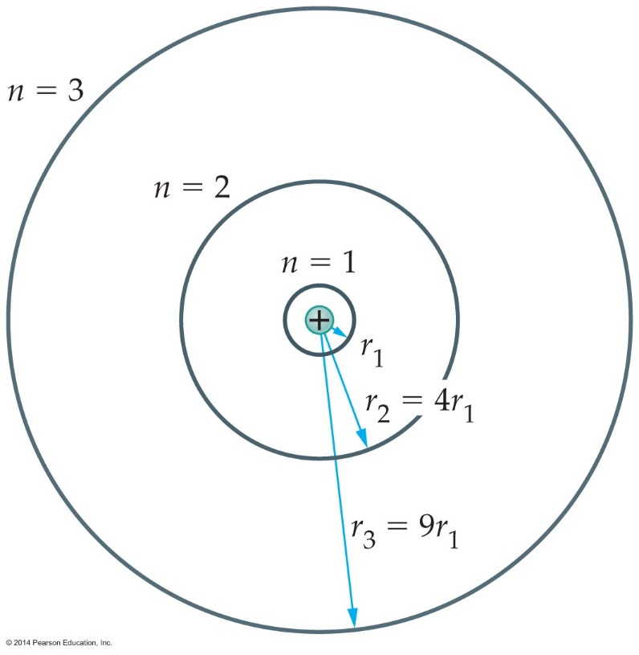
Bohr's Model of the Hydrogen Atom
The radius of the first Bohr orbit, which corresponds to n = 1, is
r₁ = 5.29 x 10⁻¹¹ m
This is known as the Bohr radius. It sets the typical size of a hydrogen atom. The higher orbits in the Bohr model increase in radius as n², as indicated in the figure below.

Slide 22
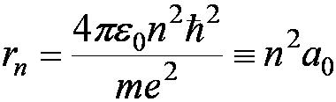
radius of the hydrogen atom for stationary states, n = 1, 2, 3, …
The smallest diameter of the hydrogen atom is two times the Bohr radius ≈ 1 Å = 0.1 nm
n = 1 gives its lowest energy state (called the “ground” state), there is formally no E₀ since quantum numbers start with 1 and are positive integers
Note that this is a “flat model”, apparently 2D
But some books may call it E₀ nevertheless, E₁ is also called 1 Rydberg ≈ 13.6 eV, needs to be divided by h and c in order to get the Rydberg constant in m⁻¹

Slide 23
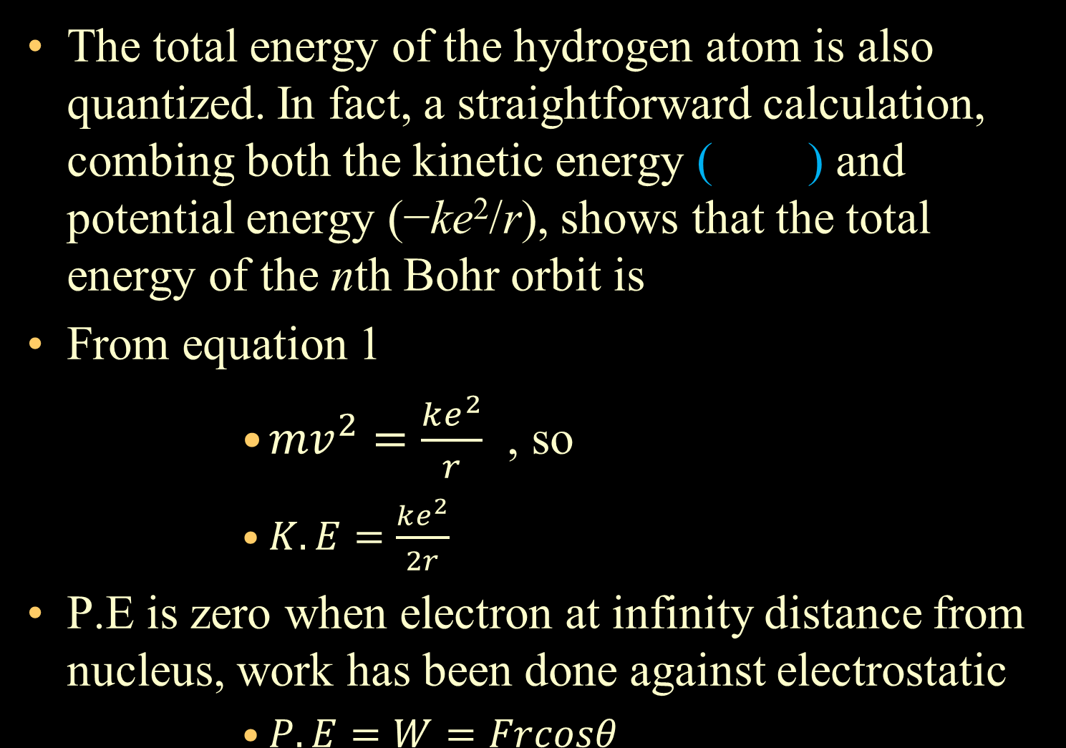

Bohr's Model of the Hydrogen Atom

Slide 24
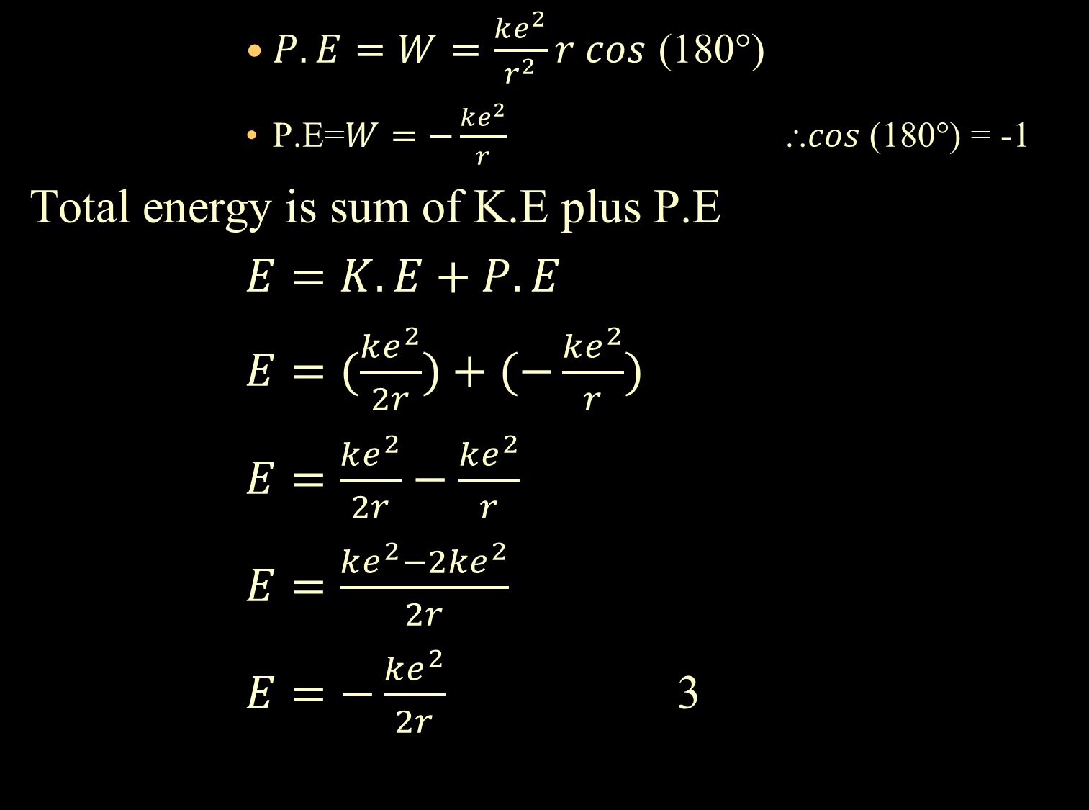

Slide 25
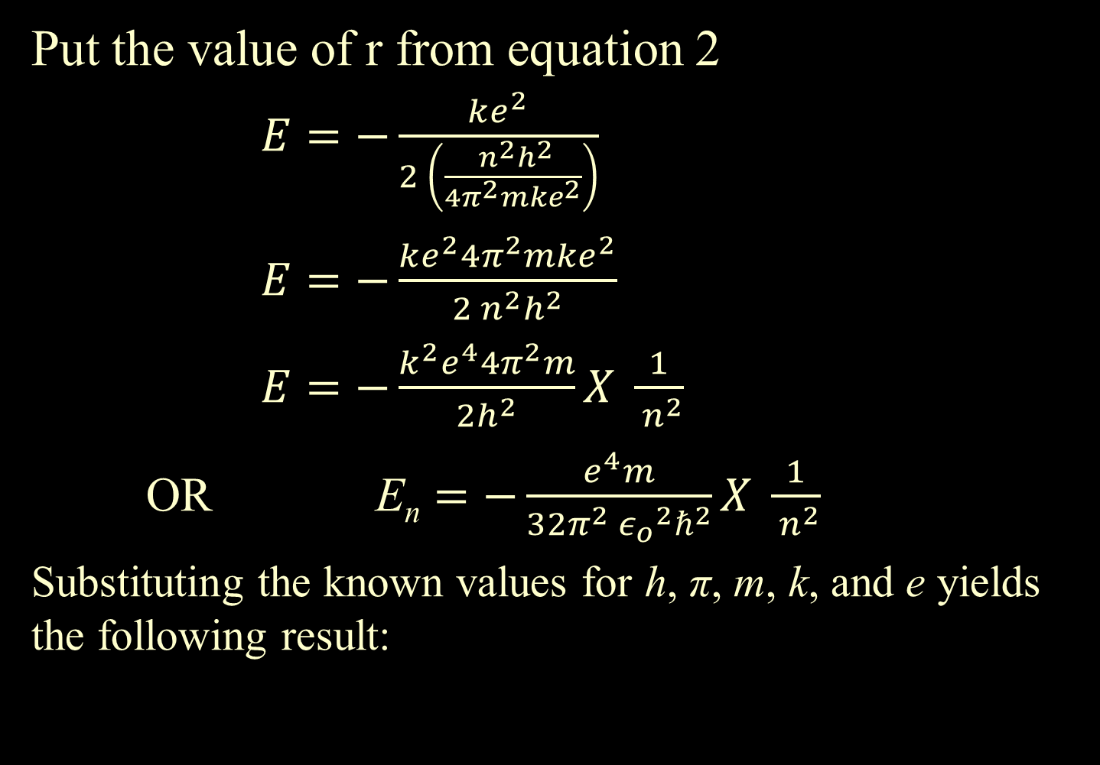
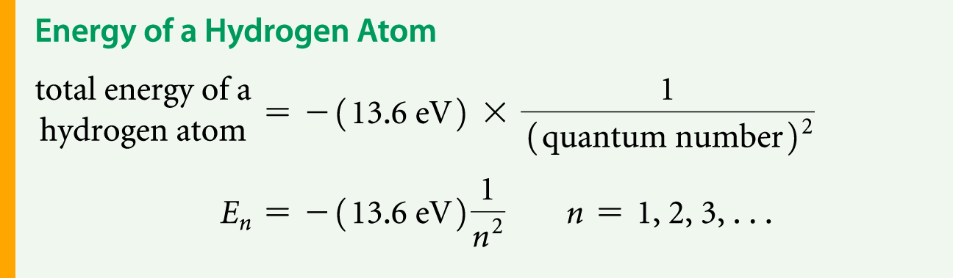

Slide 26
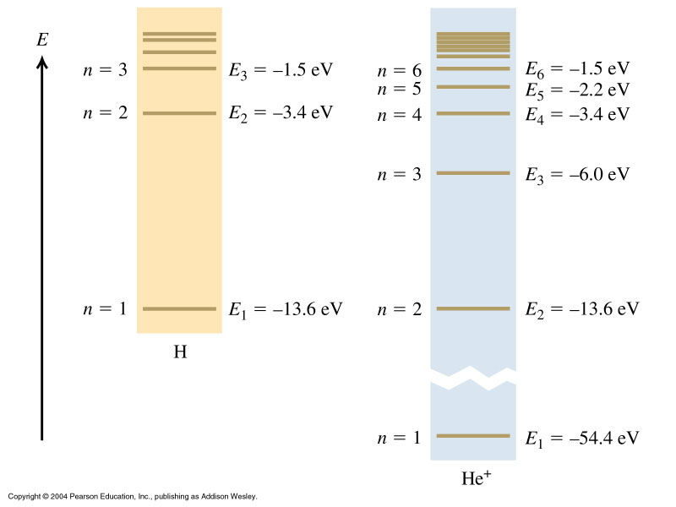
Ionized Helium is also a 1-electron atom

Slide 27
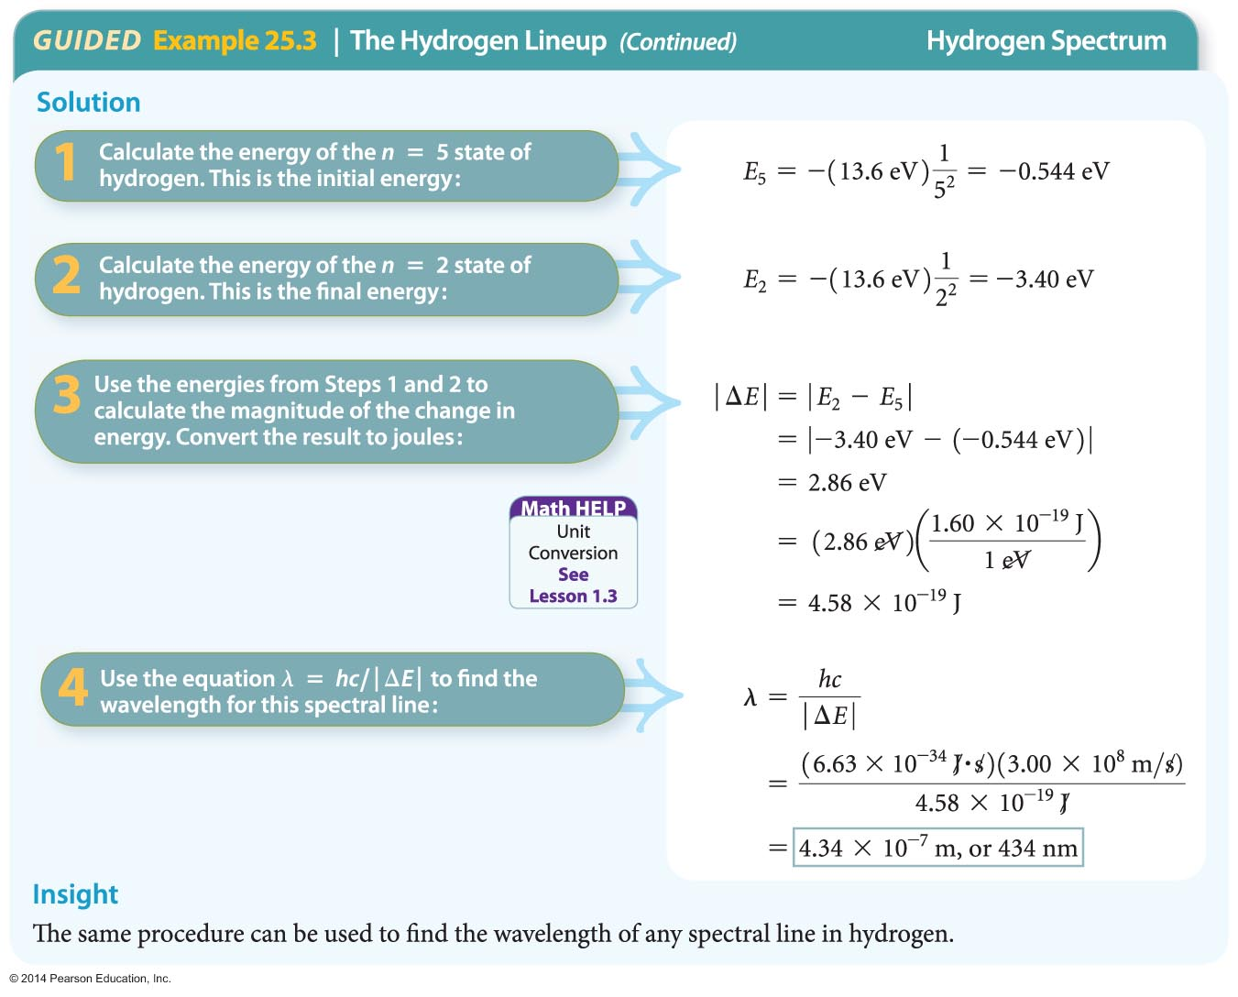
Bohr's Model of the Hydrogen Atom

Slide 28
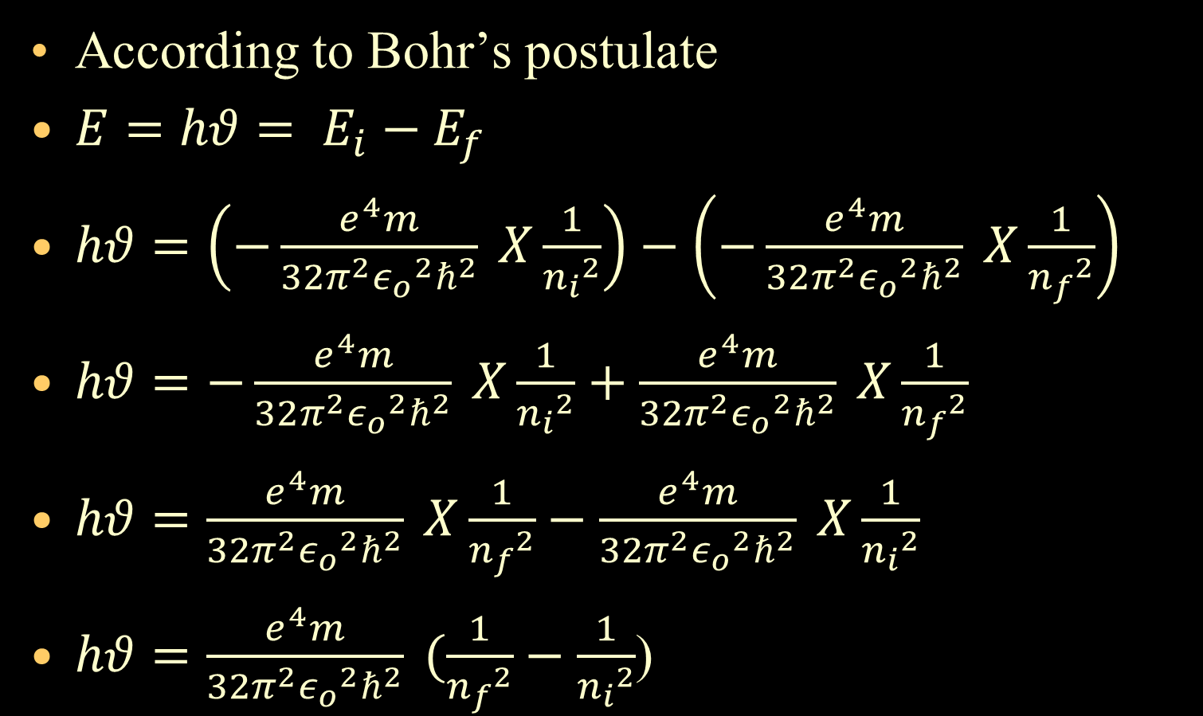
Frequency of the Hydrogen Atom
According to Bohr’s postulate
$E=hθ= E_{i}−E_{f}$
$hθ=\left(−\frac{e^{4}m}{32π^{2}{ε_{o}}^{2}ℏ^{2}} X\frac{1}{{n_{i}}^{2}}\right)−\left(−\frac{e^{4}m}{32π^{2}{ε_{o}}^{2}ℏ^{2}} X\frac{1}{{n_{f}}^{2}}\right)$
$hθ=−\frac{e^{4}m}{32π^{2}{ε_{o}}^{2}ℏ^{2}} X\frac{1}{{n_{i}}^{2}}+\frac{e^{4}m}{32π^{2}{ε_{o}}^{2}ℏ^{2}} X\frac{1}{{n_{f}}^{2}}$
$hθ=\frac{e^{4}m}{32π^{2}{ε_{o}}^{2}ℏ^{2}} X\frac{1}{{n_{f}}^{2}}−\frac{e^{4}m}{32π^{2}{ε_{o}}^{2}ℏ^{2}} X\frac{1}{{n_{i}}^{2}}$
$hθ=\frac{e^{4}m}{32π^{2}{ε_{o}}^{2}ℏ^{2}} (\frac{1}{{n_{f}}^{2}}−\frac{1}{{n_{i}}^{2}}$)

Slide 29
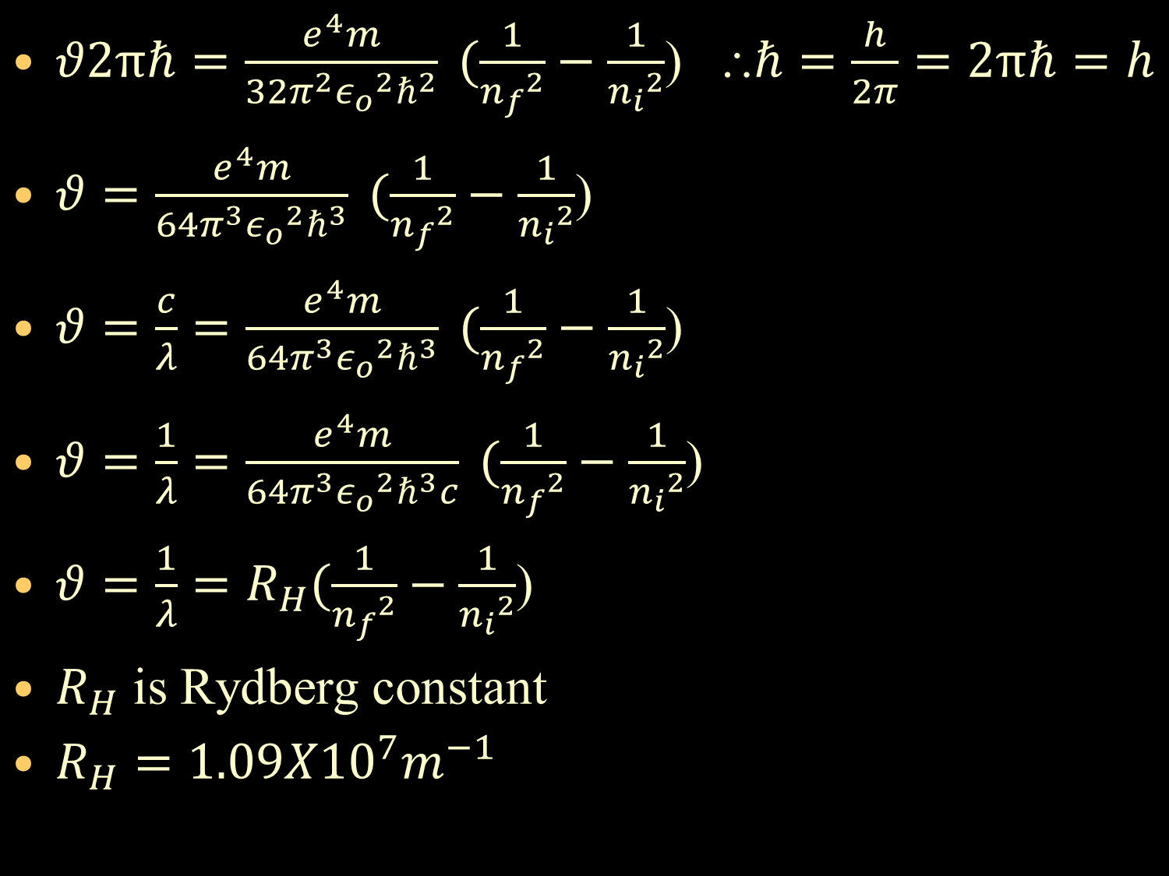
$θ2πℏ=\frac{e^{4}m}{32π^{2}{ε_{o}}^{2}ℏ^{2}} (\frac{1}{{n_{f}}^{2}}−\frac{1}{{n_{i}}^{2}}$) $⸫ℏ=\frac{h}{2π}=2πℏ=h$
$θ=\frac{e^{4}m}{64π^{3}{ε_{o}}^{2}ℏ^{3}} (\frac{1}{{n_{f}}^{2}}−\frac{1}{{n_{i}}^{2}}$)
$θ=\frac{c}{λ}=\frac{e^{4}m}{64π^{3}{ε_{o}}^{2}ℏ^{3}} (\frac{1}{{n_{f}}^{2}}−\frac{1}{{n_{i}}^{2}}$)
$θ=\frac{1}{λ}=\frac{e^{4}m}{64π^{3}{ε_{o}}^{2}ℏ^{3}c} (\frac{1}{{n_{f}}^{2}}−\frac{1}{{n_{i}}^{2}}$)
$θ=\frac{1}{λ}=R_{H}(\frac{1}{{n_{f}}^{2}}−\frac{1}{{n_{i}}^{2}}$)
$R_{H}$ is Rydberg constant
$R_{H}=1.09X{10}^{7}m^{−1}$

